Slide 1
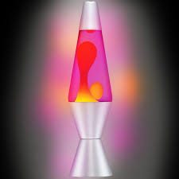
Lava Lamp Experiment
By Room 18
St. Vincent’s GNS

Slide 2
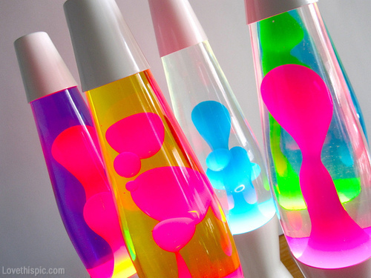
About the Lava Lamp:
The lava lamp was created in 1948 by Edward Craven Walker.
It was originally known as the Astro Globe.
They were very popular in the 1960s and 1970s.
The most expensive lava lamp ever sold was for €13,000.

Slide 3
Making a Lava Lamp :

Slide 4
What You Need:
Water Bottle
Water
Oil
Food Colouring
Fizzy Tablet
Eg : Berocca boost

Slide 5
Steps:
First fill the bottle a quarter of the way up with water.
Now add two thirds of the capacity of the bottle with oil.
Now add about 10 drops of food colouring to the bottle.
Break a fizzy tablet in half and drop it in the bottle.

Slide 6
Results:
When the oil is added to the water they separate .
When the food colouring is added it dissolve in the water not the oil.
When the fizzy tablet is added chemicals react with water and this causes bubbles.
The effect this creates is like a lava lamp.
The food colouring moves around the bottle like lava .

Slide 7
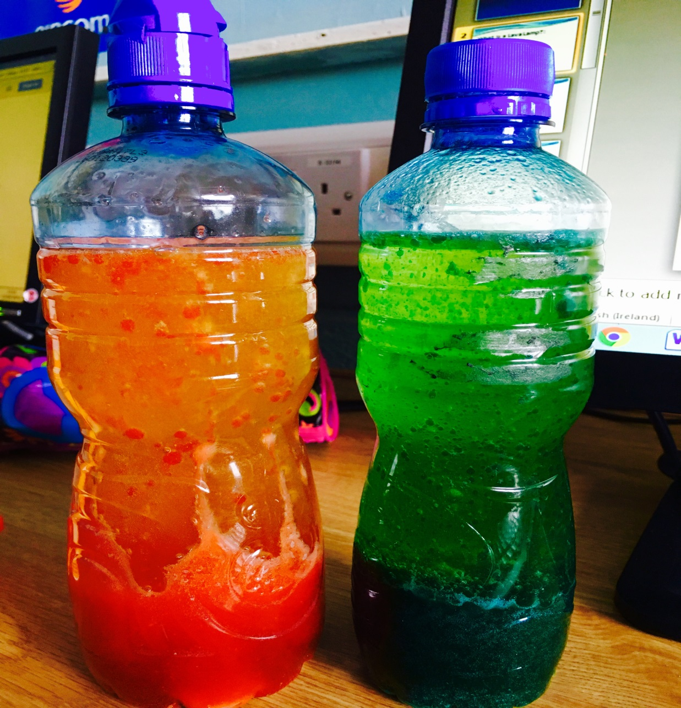
Results:
WOW!

