Slide 1
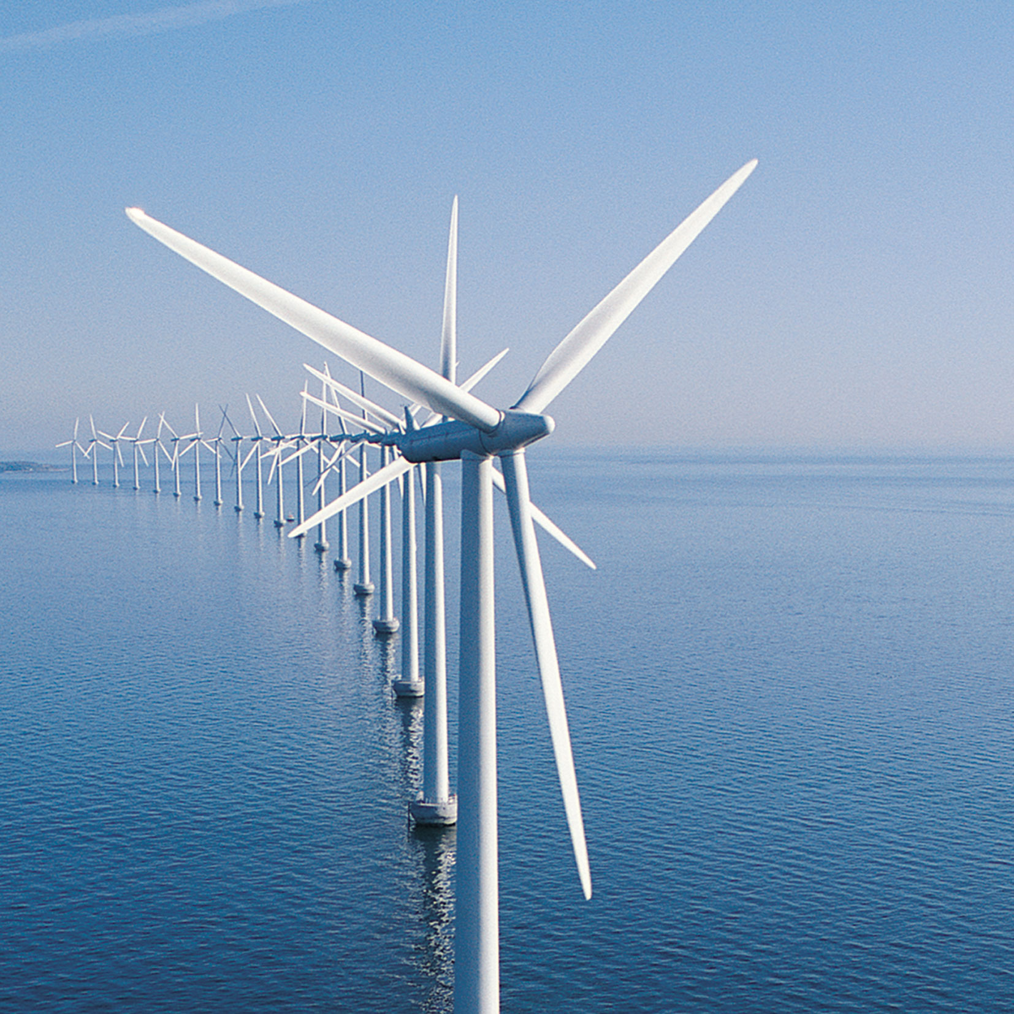
Wind energy

Slide 2
Wind in action: When wind strikes an object, it exerts a force in an attempt to move it out of the way. Some of the winds’ energy is transferred to the object, in this case the windmill, causing it to move.
History of Wind usage:
one of the earliest energy resources.
Recorded in history, first to power boats and grind grain, later to pump water, press oil, saw lumber and make paper.
Windmills were mentioned at the beginning of Islamic civilization (7th century).
Windmills were developed in Persia and used paddles made of bundled reeds.
Egyptians may have been the first to go up the Nile river around 4th century B.C, powered by wind.
Ancient Chinese used vertical axis windmills to grind grain and pump water.
Windmills were introduced to Europe by the crusaders around 1300 A.D
*windmills used for pumping water.
Wind Today!!!
Windmills are used for pumping water from deep underground.
Modern wind turbine is the result of design and material advances made during the 1980s and 1990s, which enabled wind turbines to become increasingly efficient.
Today, wind turbines are size same as the traditional European windmill. It can generate 250 to 300 kilowatts of power- a nearly tenfold increase in efficiency.

Slide 3
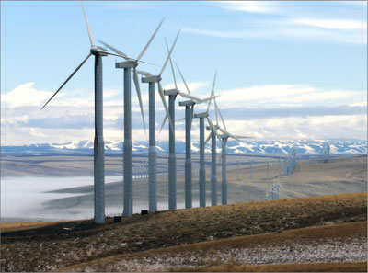
How do you convert wind into electricity???
Wind turbines convert the kinetic energy in the wind into mechanical power.
This mechanical power can be used for specific tasks (such as grinding grain or pumping water) or a generator can convert this mechanical power into electricity.
A wind turbine works the opposite of a fan.
Instead of using electricity to make wind, like a fan, wind turbines use wind to make electricity. The wind turns the blades, which spin a shaft, which connects to a generator and makes electricity.
The energy in the wind turns two or three propeller-like blades around a rotor. The rotor is connected to the main shaft, which spins a generator to create electricity.
Wind turbines are mounted on a tower to capture the most energy. At 100 feet (30 meters) or more above ground, they can take advantage of faster and less turbulent wind.

Slide 4
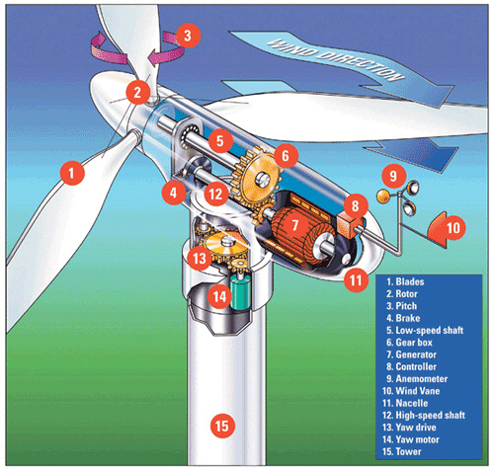
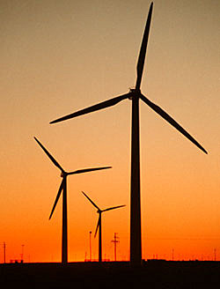
wind turbine:
A Wind Turbine

Slide 5
A Wind Turbine
Pitch
Rotor
Blades
Generator
Tower

Slide 6
Specific components
Description
2. Is the rotor. The rotor provides the blades to rotate. 4. This is brake. It’s very important to have a brake in a wind turbine, if something is wrong or it is going to fast. Then it will brake and stop the wind turbine.
5. is a low-speed shaft, it goes into a big cog wheel and this goes into a smaller cog wheel. The small cog wheel rotates faster than the big cog wheel. 7. This is the generator. It’s almost like a generator in a car. 13. It’s a yaw draw, it makes the wind turbine rotate in the wind direction. 15. Is the tower. The entrance is placed in the bottom of the tower
Wind turbine

Slide 7
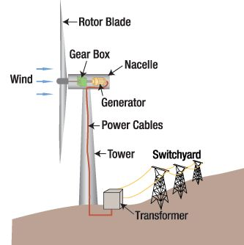
How the does a wind turbine works?
Wind turbines operate on a simple principle:
The energy in the wind turns the propeller-like blades around a rotor. The pitch of the blades makes optimum use of the wind direction.
The rotor is connected to the main drive shaft, which spins a generator to create electricity.
Wind turbines are mounted on a tower to capture the most energy. At 30 metres or more above ground, they can take advantage of faster and less turbulent wind.
Wind turbines can be used to produce electricity for a single home or building, or they can be connected to an electricity grid for more widespread electricity distribution.

Slide 8
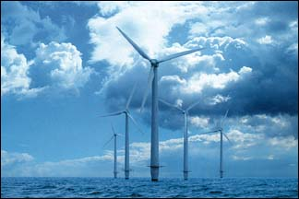
Advantages and Disadvantages???
Advantages:
No pollution.
Lowest prices renewable resources
Don’t produce atmospheric emissions that cause acid rains and green house effects.
Disadvantages:
Depending on how energetic a wind site is, the wind farm may or may not be cost competitive.
Wind energy cannot be stored (unless batteries are used)
Good wind sites are often located in remote locations
Wind resource development may compete with other uses for the land and those alternative uses may be more highly valued than electricity generation.
sometimes birds have been killed by flying into the rotors

Slide 9
General advantages
Wind energy is friendly to the surrounding environment, as no fossil fuels are burnt to generate electricity from wind energy
Wind turbines requires less space than average power stations.
When combined with solar electricity, this energy source is great for developed and developing countries to provide a steady, reliable supply of electricity

Slide 10
General disadvantages
The main disadvantage regarding wind power is down to the winds unreliability factor. In many areas, the winds strength is not enough to support a wind turbine
Wind turbines generally produce allot less electricity than the average fossil fuelled power station, which means that multiple wind turbines are needed to make an impact.

Slide 11
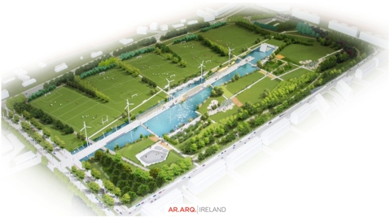
Father Collin’s Park Donaghmede
Ireland’s first wholly sustainable park.
According to Dublin City Council, the park is has the capacity to be entirely self-sufficient.
There are five wind turbines there that harness the wind and provide the energy the park’s lighting, aeration and water features.
The park also features five soccer pitches and three lakes. There is a stage and an amphitheater.

Slide 12
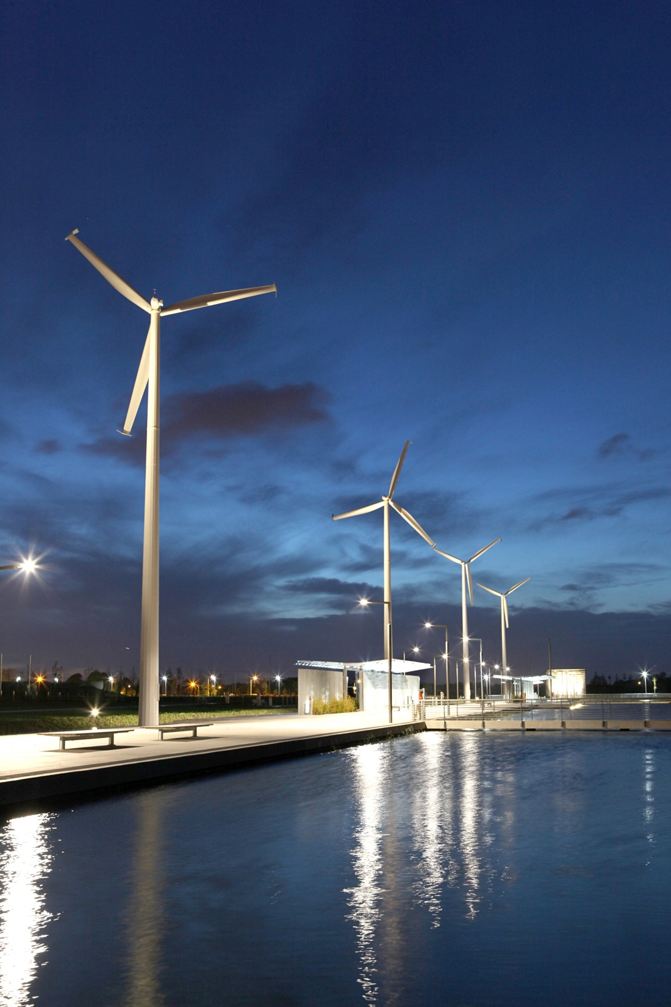
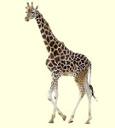
Father Collin’s Park Donaghmede
The turbine rotor diameter is 15 metres, and the overall height to blade tip is 32.5 metres.
Each of the five turbines is rated at 50 kW. Together they will save an estimated 163 tonnes of CO₂ per year.
32.5 metres is roughly the same height as five giraffes standing on top of one another.

Slide 13
